Slide 1

CLIL Activities

Slide 2
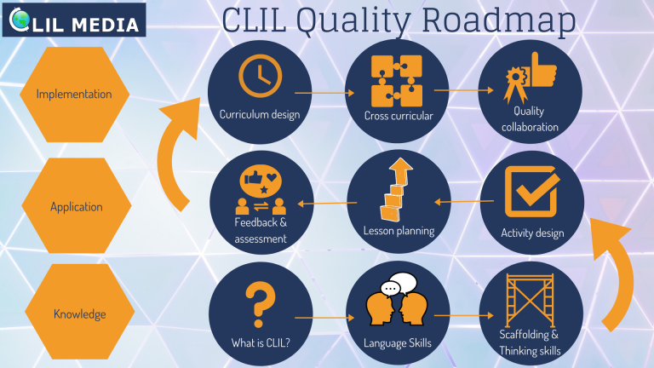
The steps

Slide 3
What should be included?
A subject topic and learning goal: what your students will know when the activity is finished.
A language goal: which aspects of the language will be passively learnt?
An active learning component:every student should be participating and has to have a certain level of responsibility. Ask yourself the question: How do I make sure every student is involved?

Slide 4
Preparing a CLIL Activity
If you sit down to create a CLIL activity for the next lesson, think about your topic and answer the three questions below:
What is my learning objective?
What is my language objective?
How can I make sure every student is involved?
Sometimes the language might actually be more important than the subject, but that’s up to to you.
Other ways to make sure you integrate language is by asking students to write something down and discuss this in pairs later on. No matter the subject, you just used language. If you follow-up with the assignment that someone will be randomly selected to present the answer, everyone will participate otherwise they might end up not being able to answer questions.

Slide 5
Alphabet
Homework Discussion
Scan the Chapter
Describe in your Own Words
Word to Sentence
Some activities
that don’t need
preparation

Slide 6
Alphabet
Activity: ask students to brainstorm words starting with each letter of the alphabet belonging to a specific topic
This is a great way to help your students realise how many English words they already know and it will boost their confidence
Split your class into teams and allow students to brainstorm for 2 minutes and write down as many words as they can.
When time’s up, go through each letter as a class and complete the missing ones. This will help them develop and learn new words.

Slide 7
Homework Discussion
In pairs students discuss their homework within a time limit
Then teacher would ask a specific question for students to answer and explain. They have one minute to think of the best way to answer/explain.
Then teacher randomly chooses a student to answer
When we give students to think of how to explain a task, we allow them to think of what language they will use to explain

Slide 8
Scan the Chapter
It is impossible for the teacher to explain all the words in a text
Students scan the paragraph/text/chapter and write down a list of words they find difficult to understand
As the class progresses working through the paragraph/text/chapter doing all the necessary exercises, students are responsible to find the meaning of their word list
This allows students to become more independent learners

Slide 9
Ask students to describe something using their own words and offer a word limit.
When students have a word limit, they will pay more careful attention to the language they will be using.
Describe in
your Own
Words

Slide 10
Ideal for the beginning or end of the lesson
Give students two words and they need to make a sentence about the topic
If you wish to make it more challenging, provide 3 or even 4 words
This will help students to focus on both content and language
Word to Sentence

Slide 11
Sources
https://www.clilmedia.com/5-ideas-for-engaging-clil-activities-in-class/#t-1592814765338
https://www.clilmedia.com/elements-of-a-clil-activity/

